Slide 1
Battle of the Neighborhoods
By Rex Tang

Slide 2
Intro
Use Foursquare API to find venues in Houston area
Analyze data to find optimal locations to start a new restaurant business

Slide 3
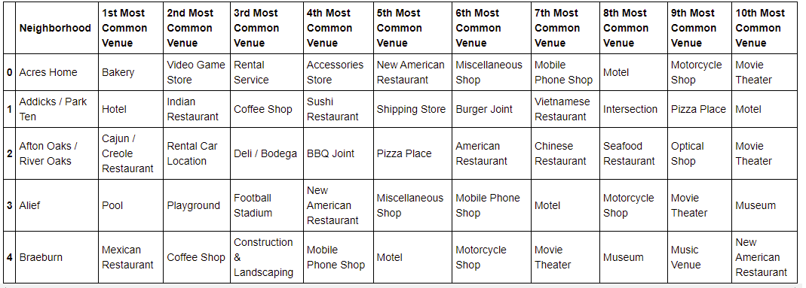
Data
Locations found on Wikipedia by webscraping
https://en.wikipedia.org/wiki/List_of_neighborhoods_in_Houston
Venues obtained through Foursquare API
Formatted to see most popular venues by neighborhood

Slide 4
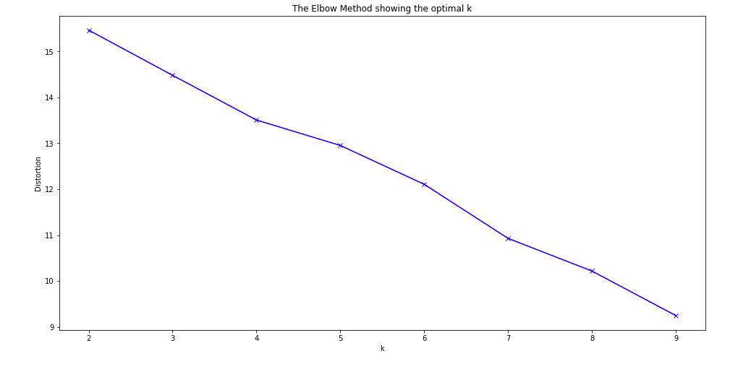
Analysis
Use k means clustering to group neighborhoods
K value used is 6

Slide 5
Results and Discussion
Optimal locations include East Houston and Westchase
Variety of venues
Less competition in restaurant business
Quality of data is lacking; too few entries for good clusters
Limited by available data

